Slide 1
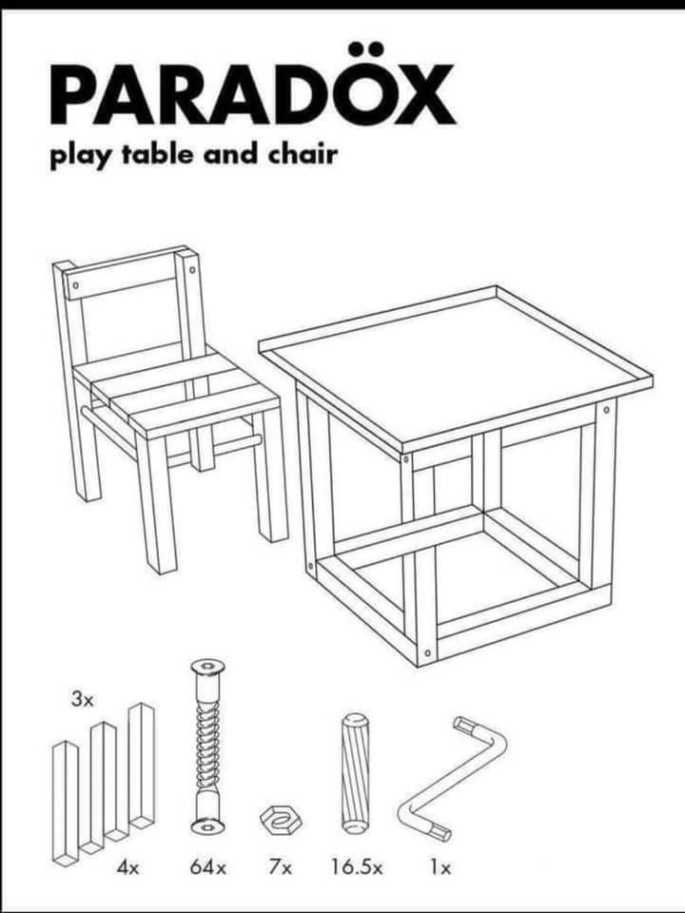

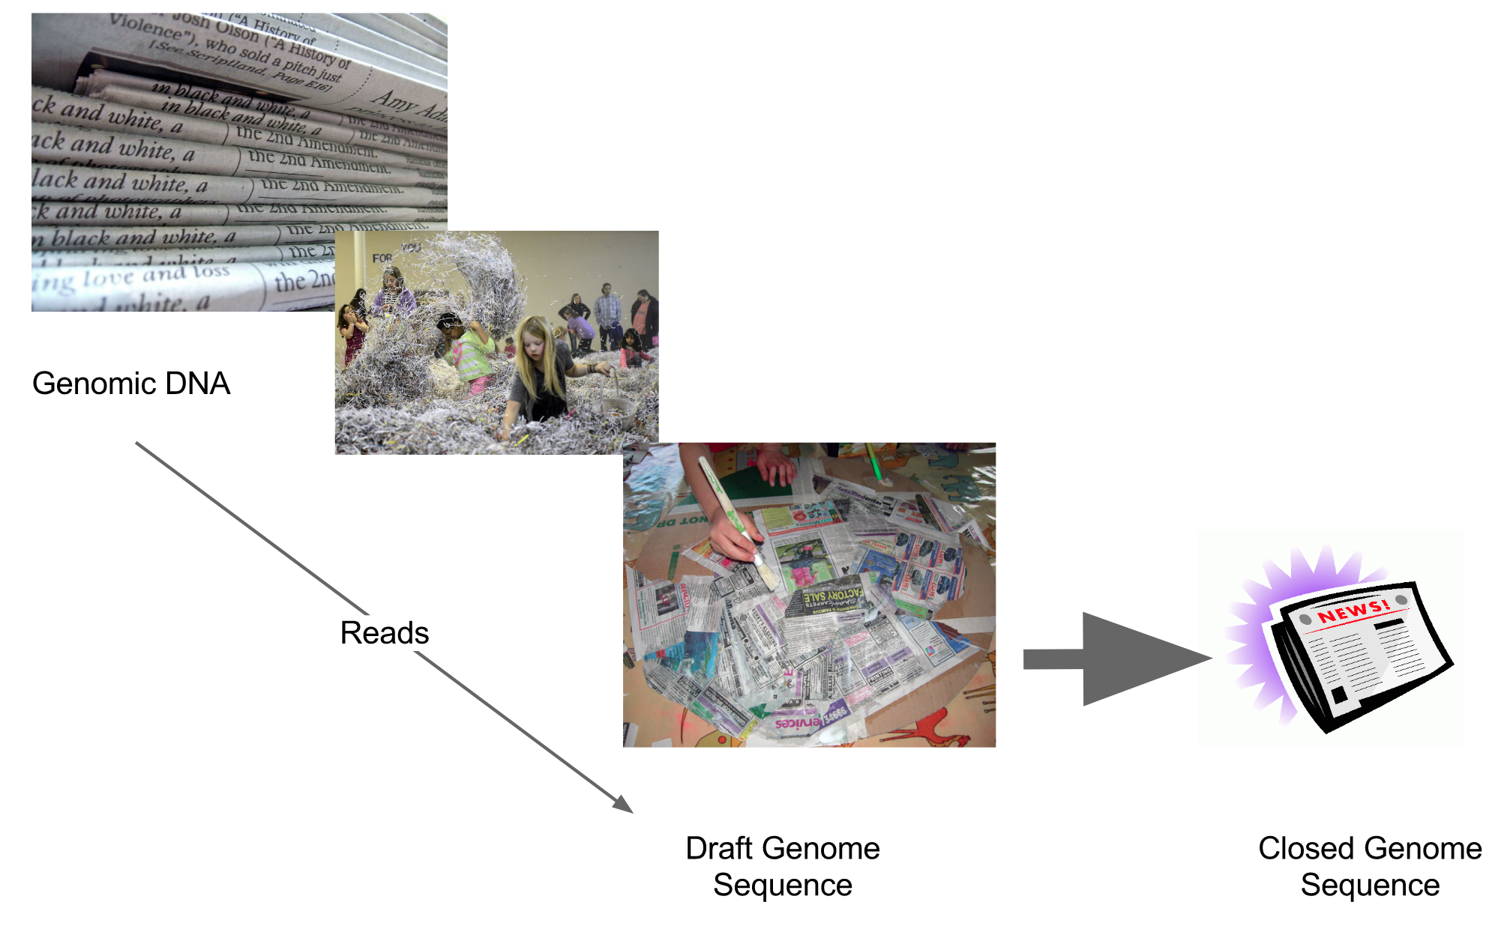
Assembly and annotation of bacterial genomes
Microbiome Analysis Course 2025
Pablo Atienza Lopez
Notes:
##-AccessibilityAssistant: Skip layout check-##

Slide 2

Outline
Read quality assessment (NanoPlot)
Read filtering (NanoFilt)
Assembly (Flye)
Results análisis (Bandage)
Polishing (Racon)
Circularization (dnaapler)
Assembly QC (Busco)
Annotation (Prokka)
Hybrid assembly (Unicycler)
All comes powered by:

Slide 3


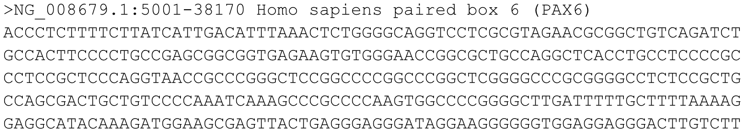
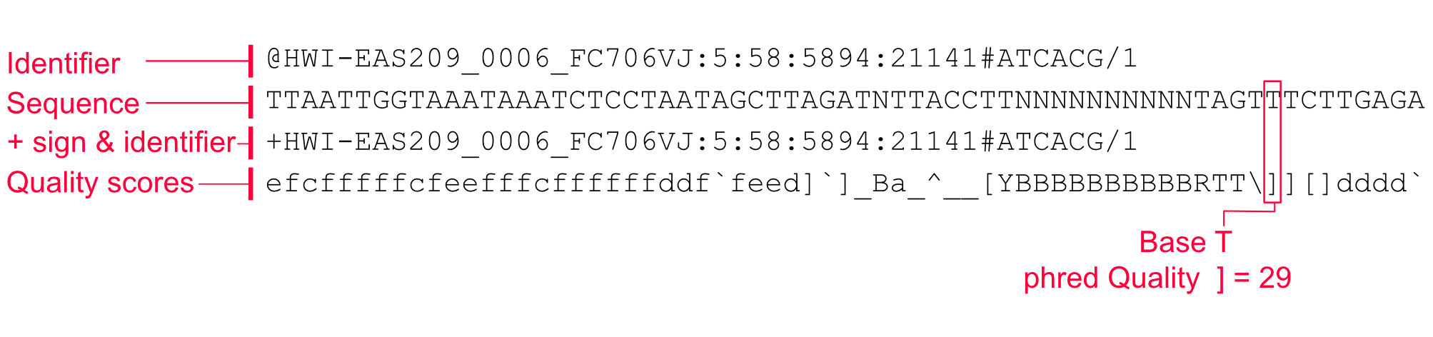
Input file types
FASTA
FASTQ
fasta
The Qler fasta
The raw reads of an experiment can be stored in two type of files:
FASTA: The identifiers of every sequence are in a header line that begins with “>”. The following lines contain the actual sequence
FASTQ: Extension of the FASTA format. Includes base quality metrics, with four lines:
Header: Begins with “@”
Sequence
End of sequence: Begins with “+”
Per base quality scores: Phred score encoded in letters and symbols

Slide 4
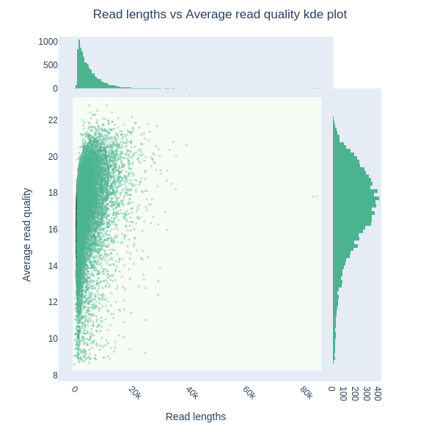
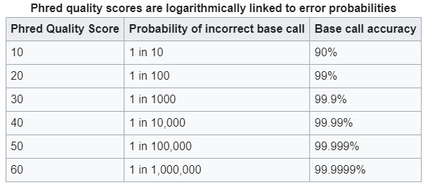
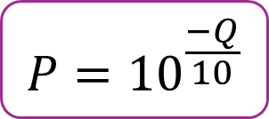
Preprocessing
$$P={10}^{\frac{−Q}{10}}$$
Assesing intial read quality
Quality (phred score)→ Estimate of the sequencing error
Length of the reads
Number of reads

Slide 5
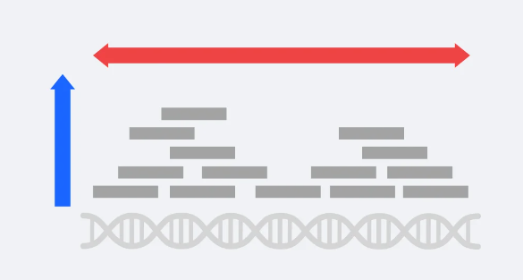



Important concept: Coverage vs. Depth
A common mistake is to confuse coverage and depth
Coverage: Proportion of the genome that has been sequence at a certain depth
Depth: Number of times a specific nucleotide has been read during the sequencing process. The average number of reads per base on a sequencing run is given by “x” (i.e. 100x = 100 reads per base on average)
Coverage
Watch out!
“My sequencing has a 40x coverage”
“My sequencing has a mean depth of 40x”
Depth
https://3billion.io/blog/sequencing-depth-vs-coverage

Slide 6

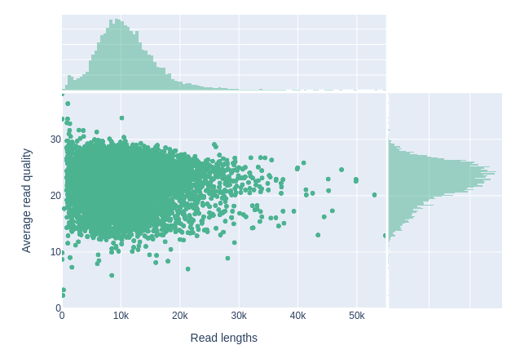
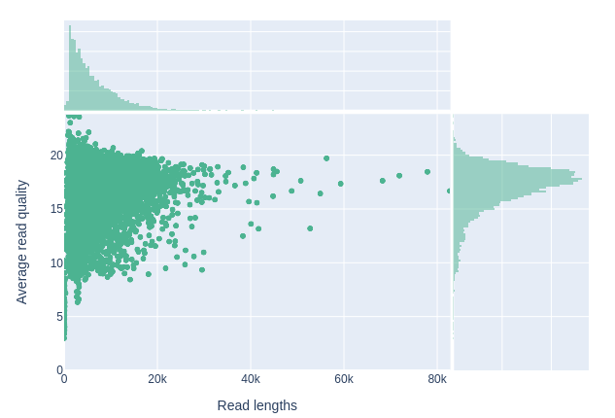
Read filtering
It is important to filter low quality reads:
Introduce bias
Where to cut? Dataset dependent

Slide 7

Assembly basics
“Process that reconstructs a whole genome sequences from a set of reads”
It works by aligning and merging the raw sequencing reads.
Mainly done by graph-based approaches:
DeBrujinn graphs → Exact matches of k-mers
Repeat graphs → Approximate sequence matches
The graphs can be visualized to assess how good the assembly is

Slide 8

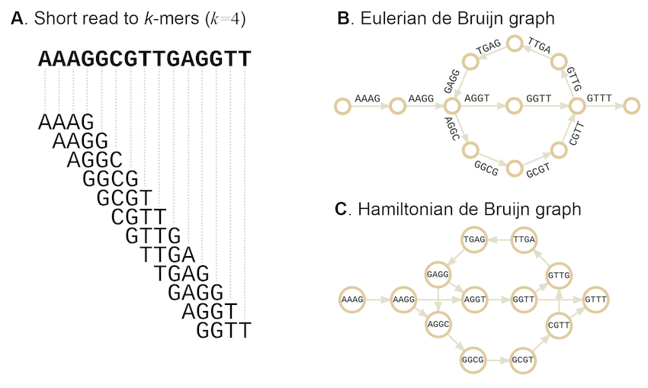
Graph example (deBrujiin)
Me explaining to my colleagues that the graph I made makes sense
Once the graph is done, a path is selected, and the contig assembled
GAGGTT AAAGGCGTTT
Shon J.,Nam JW., 2016

Slide 9
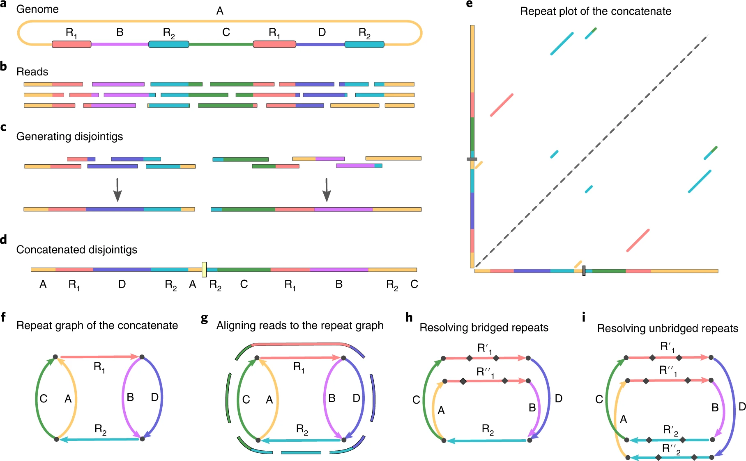
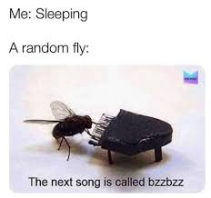
Flye
Kolmogorov et al., 2019

Slide 10

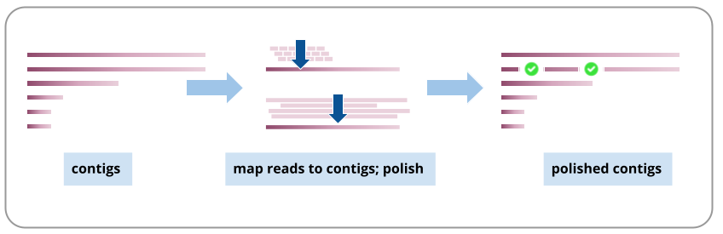
Assembly polishing
Wax on! Wax off! Repeat until a shiny assembly
is done
ONT only assemblies might come with a higher error content
Polishing is needed to fix errors caused by sequencing
It can be done from 2 sources:
Original long reads
Short-accurate reads → Hybrid assembly (further on)
https://training.galaxyproject.org/training-material/topics/assembly/tutorials/largegenome/tutorial.html

Slide 11


Racon
Contig polishing tool
Requires to overlap reads against the contigs (PAF format)
bwa-mem for short-reads
minimap2 for long reads
Uses the overlaps to determine if any nucleotide should be fixed
Recent advances in NanoPore technologies and Flye assembler may result in polishing not necessarily increasing the accuracy of the assembly. However, there are no official results. The best approach would be to check the assembly after racon, or running it multiple times to get a consensus

Slide 13

Circularization and reorientation
To submit a genome, it must always begin in the origin of replication
Gene in which it will replicate from
Most of the times:
dnaA for chromosomes
rep1 for plasmids
dnaapler: tool that automatizes the process
Looks for dnaA gene or rep1 (plasmids) and reorients the genome
When your PI realizes at the end of the analysis that the assembly does not begin in dnaA

Slide 14
Assembly quality control
Assembled genome parameters:
Length: Is it close to what would be expected?
Number of contigs: Too many contigs can be an indicator of a fragmented assembly
N50: Length of the shortest contig that contains at least half of the bases
Assembly graph: No or little loops present
Annotation parameters:
Gene completeness: Derived from a set of core genes specific to a lineage
Fragmented genes: Errors in sequencing might introduce artificial stop codons

Slide 15

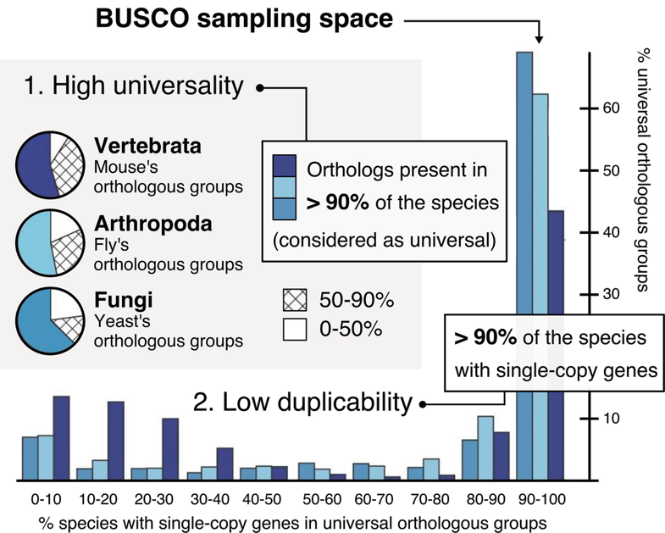
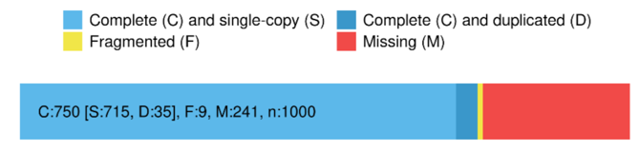
BUSCO
Tool that check for the core genes of a certain lineage
You will have to find which is the most accurate linage for you in their database
Produces a report of the “completeness” of your genome
Single : Found in one copy
(expected)
Duplicated : Found in multiple copies
Fragmented: Length deviates >2 std from the mean
Missing : Not found
Simão et al. 205

Slide 16
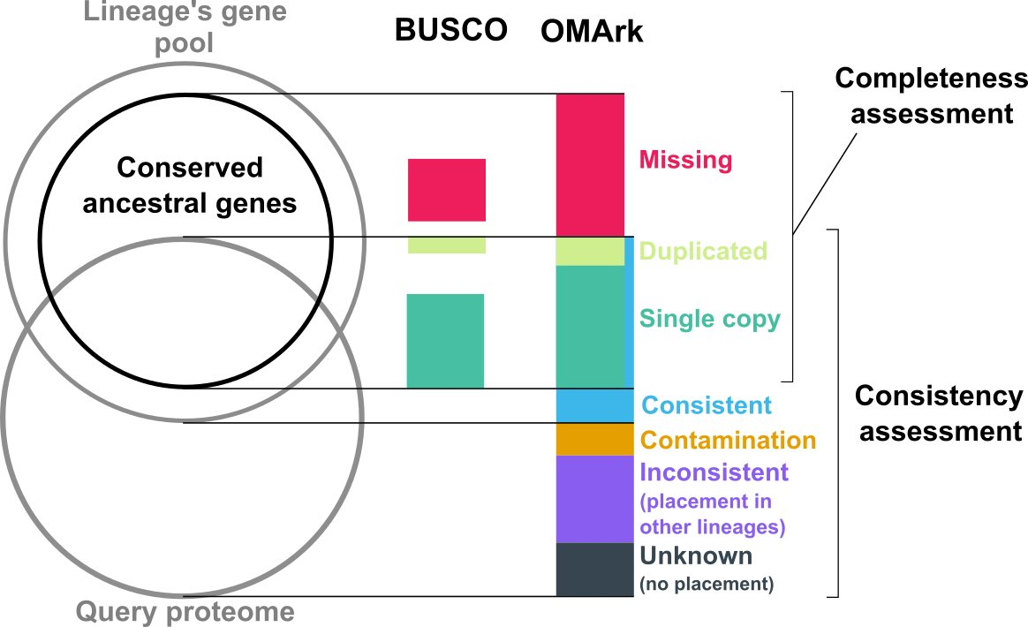
Omark
Similar to BUSCO, but it includes a more complete report
Not only gives information about completeness, but also about contamination and consistency
Places your genome under a lineage and has a bigger database than BUSCO

Slide 17
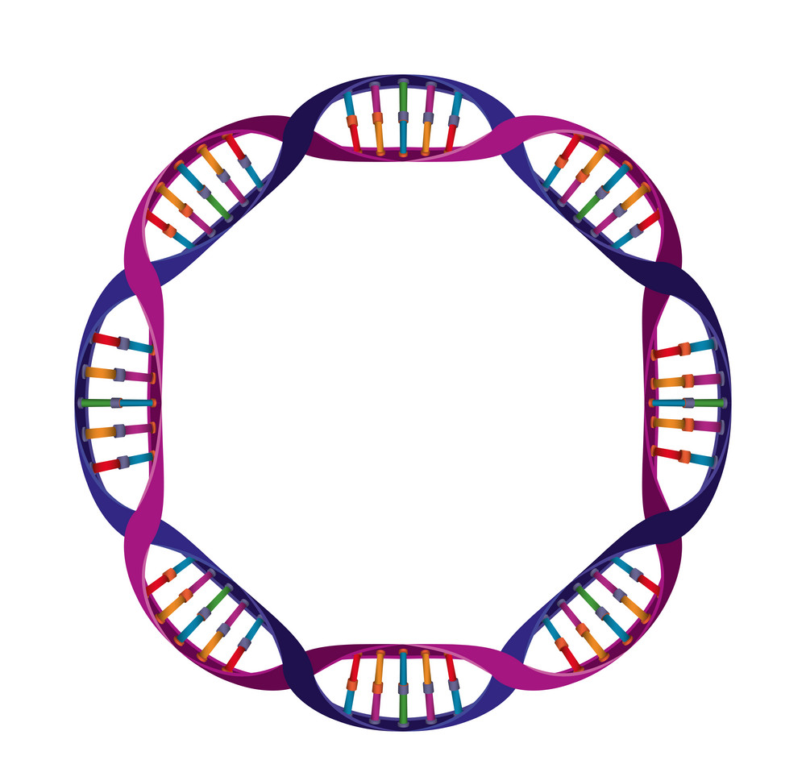
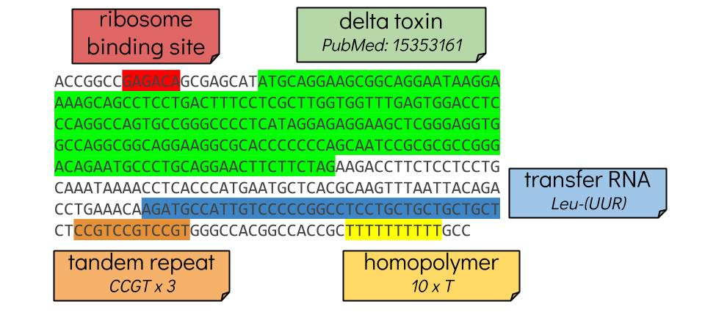
Annotation
“Process of describing the structure and function of the components of a genome”
Steps:
Find Open Reading Frames (ORFs) → Gene candidates
Assign a function to each ORF
Some might not have any → Either not a gene or not characterized yet
Include other sequence types: ncRNA, tRNAs, etc
If needed, you can search for more specific genes or regions
Anna Syme, Galaxy training

Slide 18
Output files from annotation
gff: Master annotation in GFF3 format (universal). Contains both sequences and gene information
gtf: Tab format of gff
gbk: Standard GeneBank file, derived from the master gff
fna,faa, ffn: Specific fasta files with the genes in nucleotide, aminoacid or transcript, respectively

Slide 19
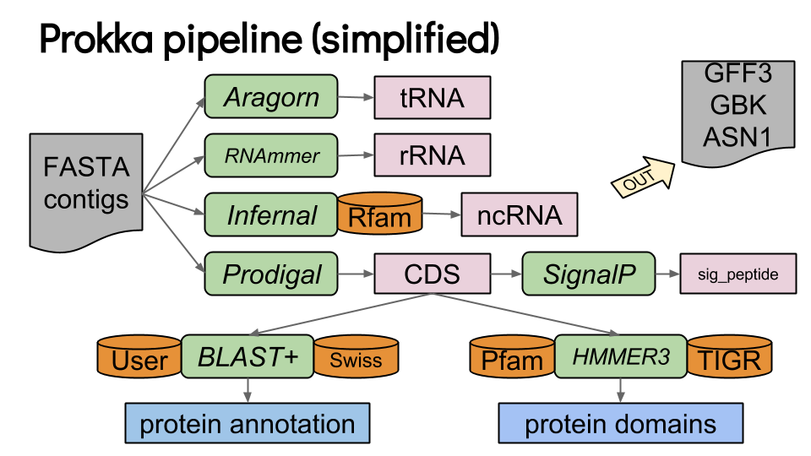
Prokka
All-in-one tool for annotation of prokaryotic genomes
Produces output in standard format
Highly customizable
Multiple databases

Slide 20

Hybrid assembly
Combining the power of both short and long reads.
Two approaches based on the available data
Assembly based
Short reads assembly → Long reads resolve
Alignment based
Long reads assembly → Short reads polish
Long reads
Short reads

Slide 21
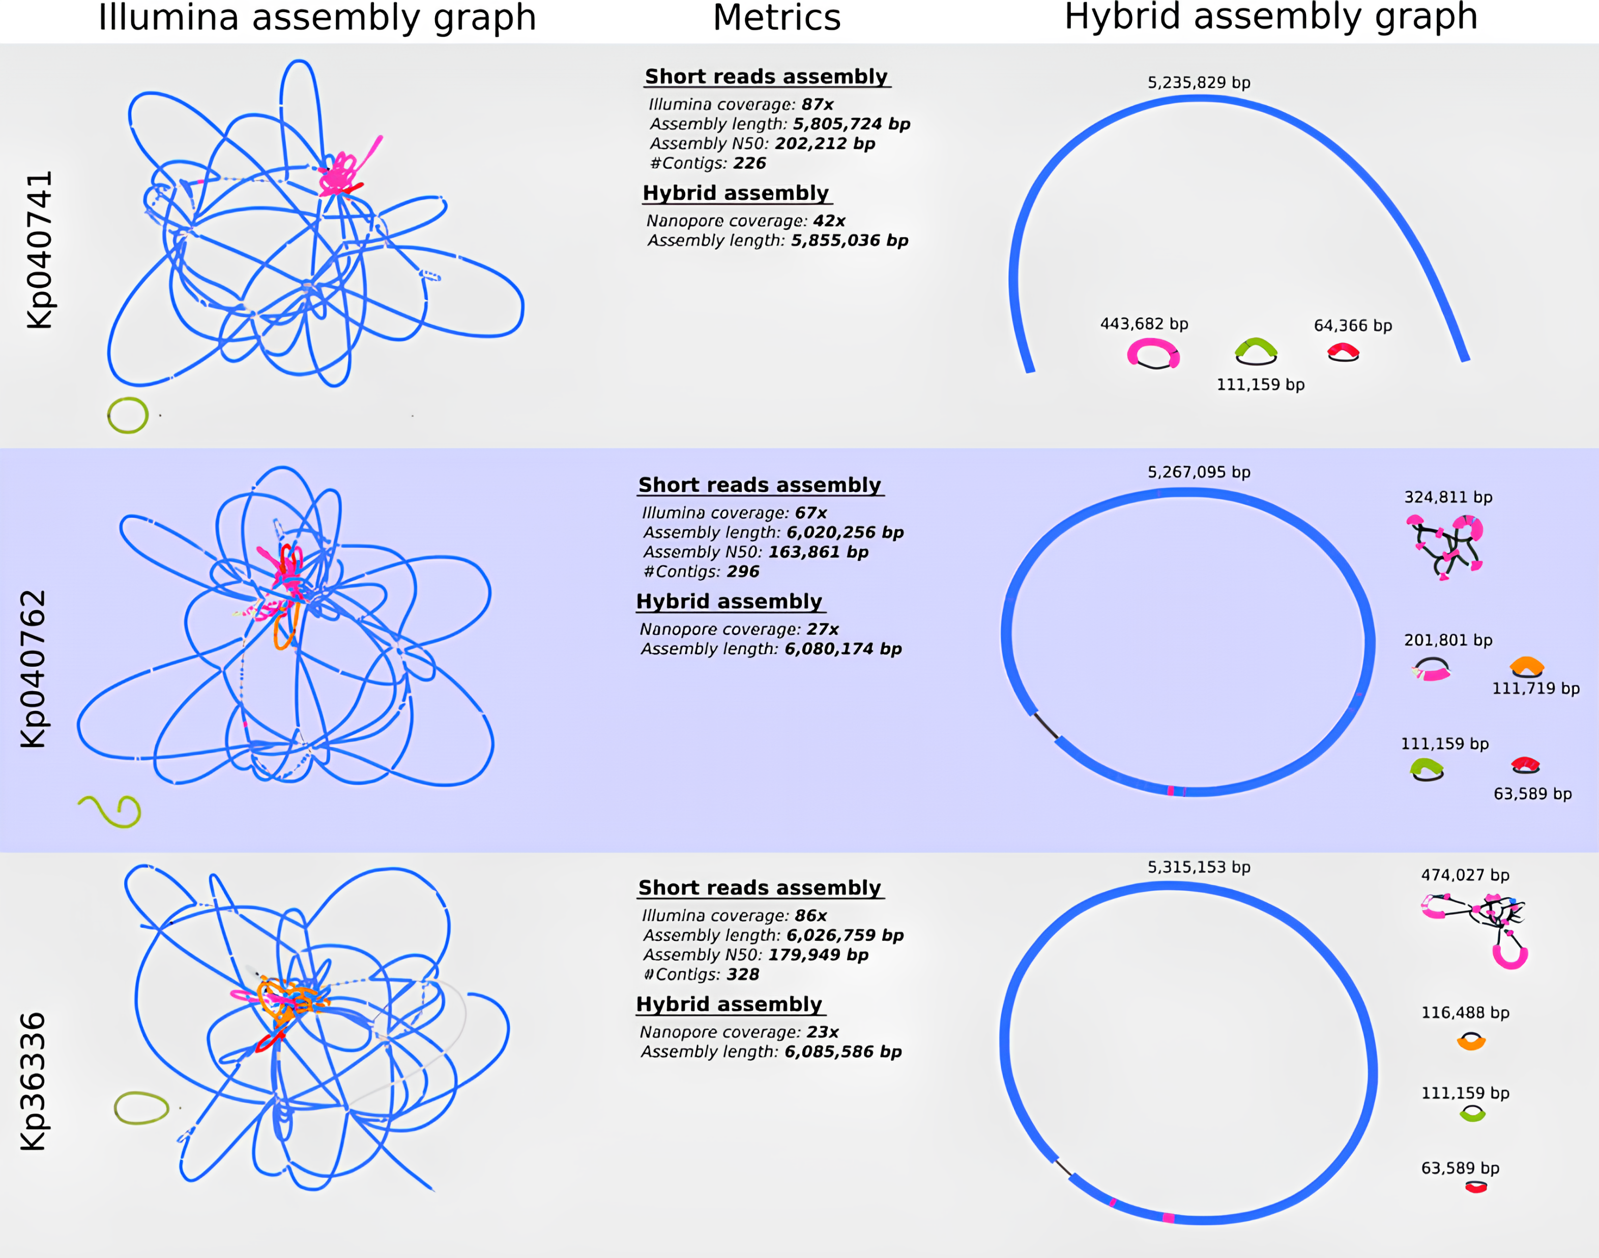
Eskenazi et al, 2022

Slide 22
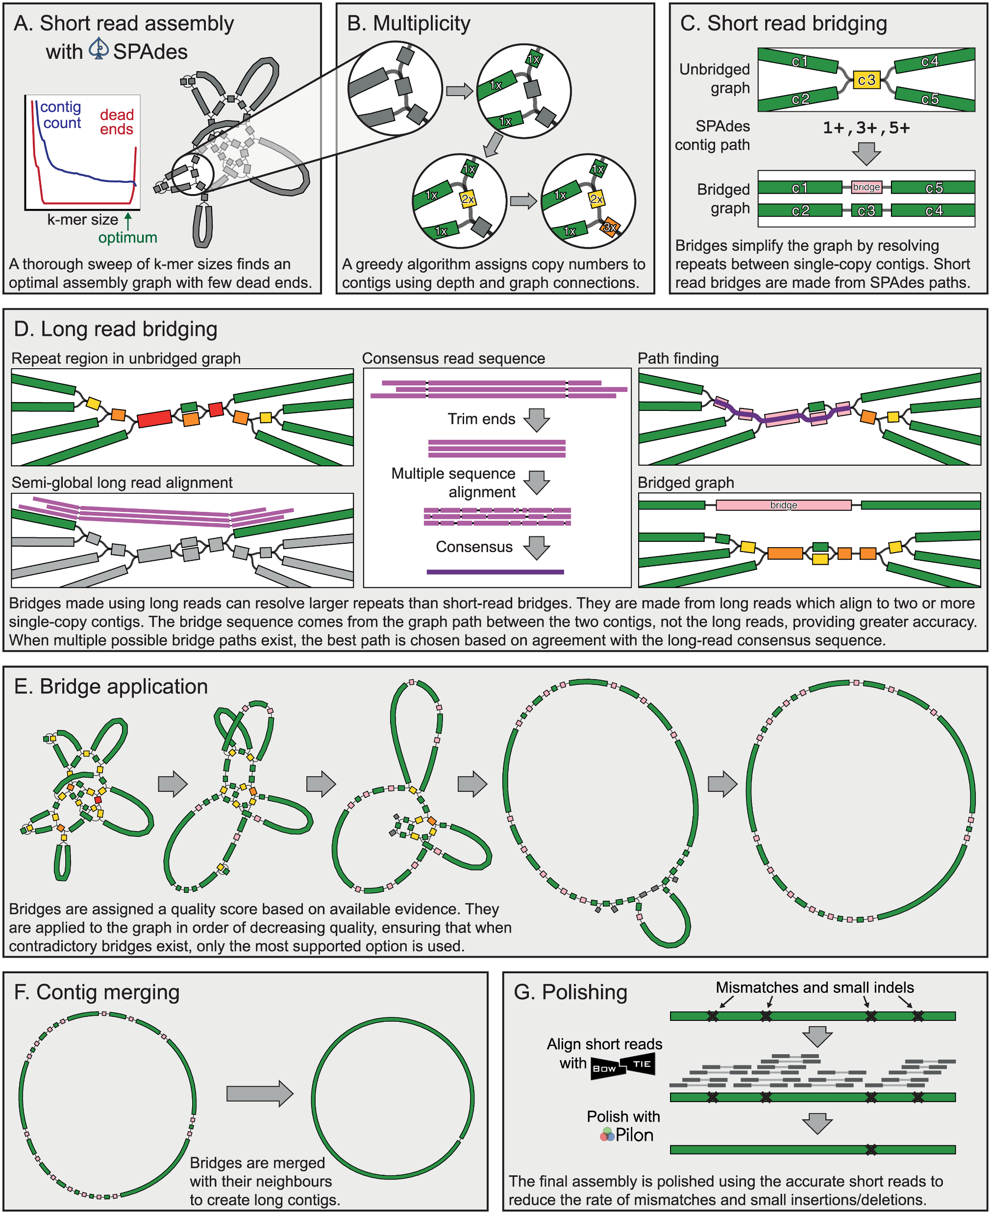
Unicycler
Go-to tool for hybrid assembly using a short-read assembly
Spades builds an initial assembly
Long reads are used to resolve the repetitive regions and bridge contigs
Wick et al, 2017

Slide 23
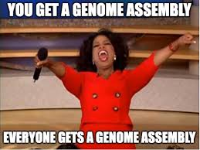
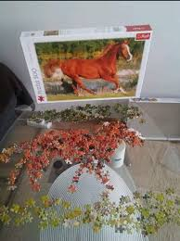

Questions & comments?
GENOMES, ASSEMBLE!

